Slide 1
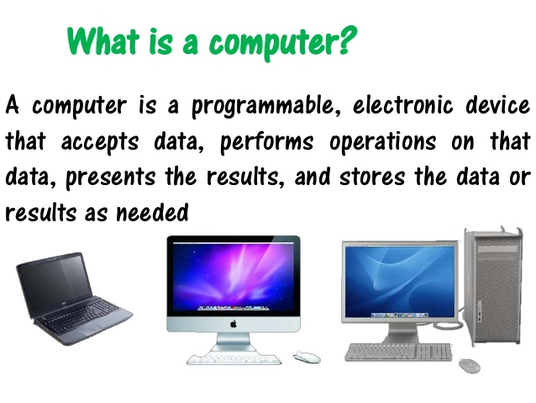
Introduction to Computers and Programming

Slide 2
Number Systems

Slide 3
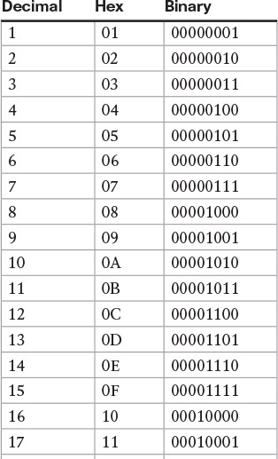
Decimal vs Binary vs Hex
Traditional numbers are in base 10 (decimal)
Computers operate in base 2 (binary)
Any number can be converted into a different base
Hex is base 16. Each hex digit represents 4 binary digits, so hex is shorthand for binary

Slide 4
Basic Computer Architecture

Slide 5
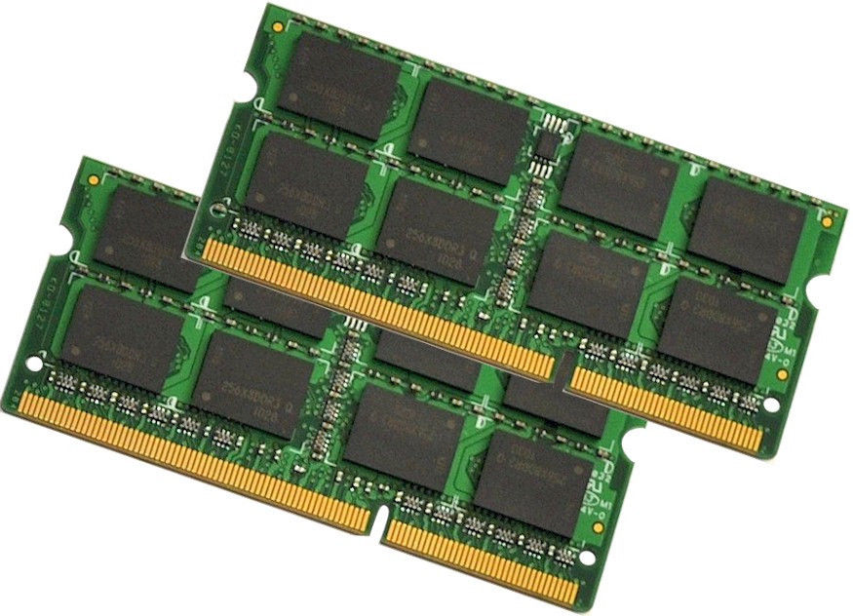

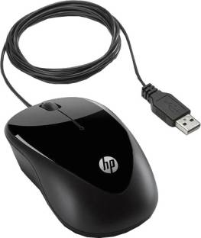
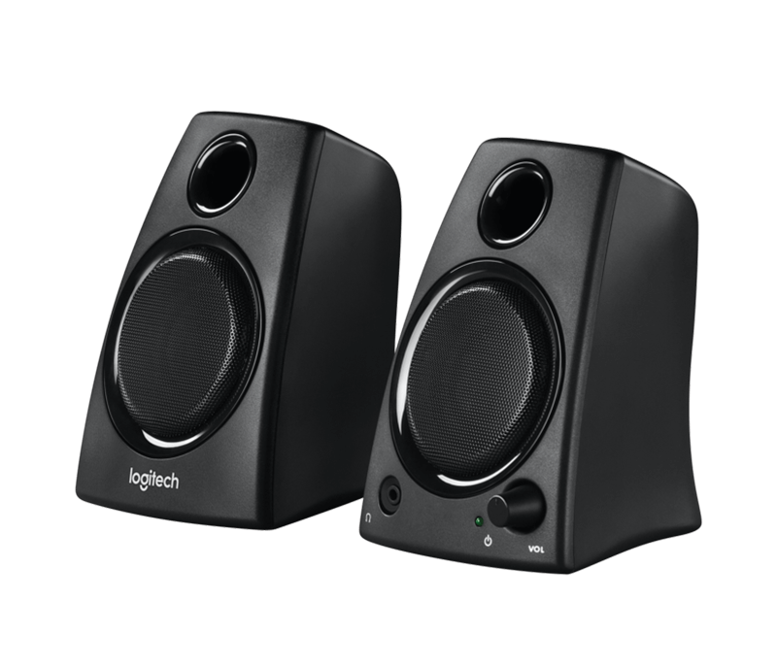
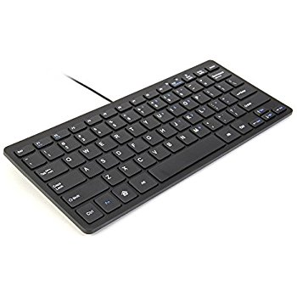
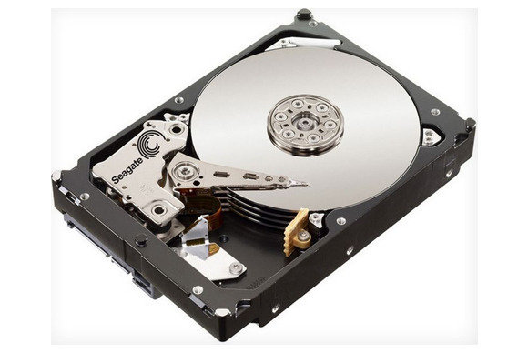
Random Access Memory (RAM)
(memory for working files, erased when computer is turned off)
Data
Inputs (mouse, keyboard, camera)
Central Processing Unit (CPU) aka the “core”
Outputs (monitor, speakers, projectors, lights)
signals
signals
Data
Hard Drive (archive of files, programs, etc., saved when computer is turned off)
Notes:
Data In vs Data Out

Slide 6
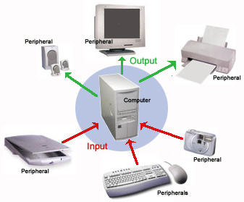
Peripherals: Outputs
Peripherals: Inputs
Examples: Mouse, keyboard, trackpad, camera, disk drive
Inputs gather information and help the processor make decisions. They are the interface for how humans tell the computer what to do.
Examples: Screen, speakers, lights, printer
Outputs display the results of the computer in ways humans can understand

Slide 7
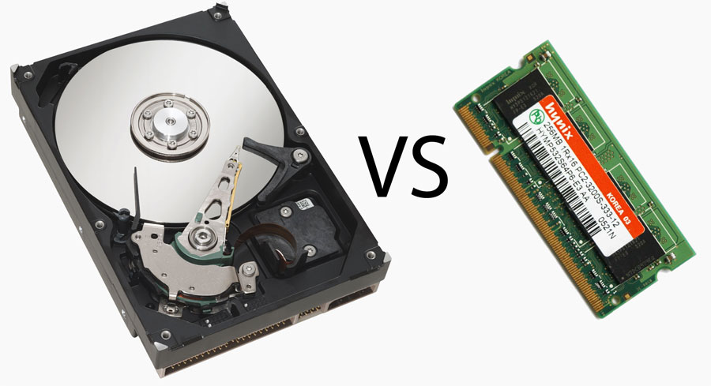
Memory (3 kinds)
Hard Drive RAM
Hard Drive (Permanent)
Stores permanent files such as: pictures, videos, program files, the operating system, etc.
Usually 128/256/512 GB or 1/2/4 TB
RAM aka Random Access Memory (Temporary)
Faster than Hard Drive
Used for running programs
Usually 2/4/8 GB
Registers (Temporary)
Part of the central processor
Each register can only hold 1 number

Slide 8
Hierarchy of Programming

Slide 9



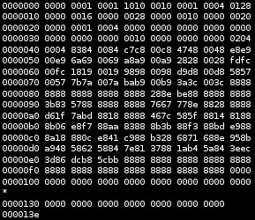

Point and click programming
Environments: Excel, Powerpoint, etc…
Languages: C, C++, Java, R, Python, HTML
Example: int counter = 1; (find memory to store an integer
variable, name it counter, and set it equal to 1)
High level
language
Language: Assembly
Example command in Hex (base 16): F3A8
Same command in Binary (base 2): 1111 0011 1010 0100
Machine code
(individual instructions)
Logic gates
Universal Gates: AND, OR, NOT
Example: ABC (A and B and C)
Example: A+B+C (A or B or C)

Slide 10
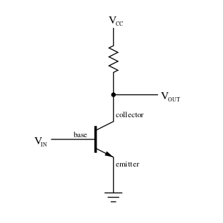
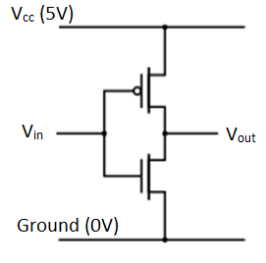
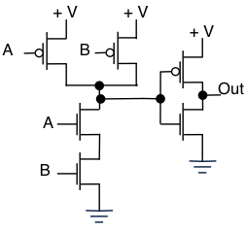
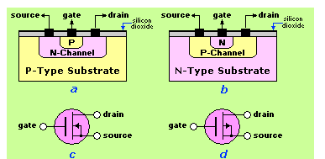
Logic Gates 1: Transistors
Transistor
Basic component of all computers
Allow for electricity to flow when certain conditions are met
Can be linked to form more complex structures
2 kinds of transistors N and P
Inverter made from 2 transistors
AND Gate made from 6 transistors

Slide 11
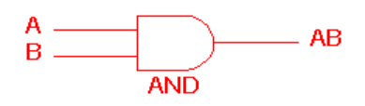
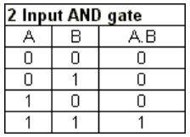
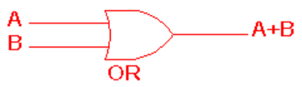
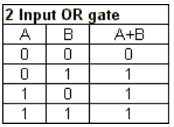
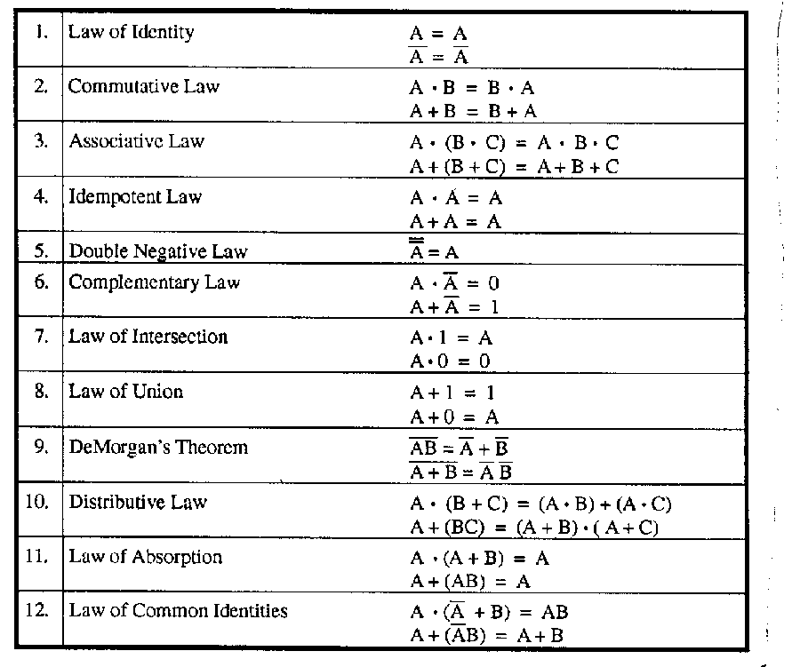
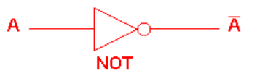
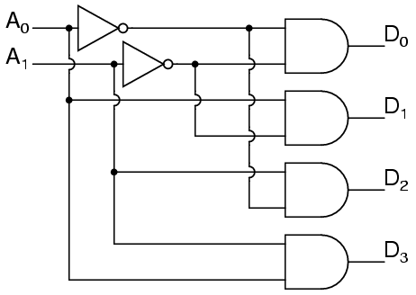
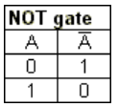
Logic Gates 2: Boolean Algebra
Use Boolean Algebra where variables are either 1 or 0
Inputs are either 1 (typically 5 Volts = “Logic 1” or “Logic High”) or 0 (0 Volts = “Logic 0” or ”Logic Low”)
Can use these AOI gates to build any logical expression
Boolean Logic
A DECODER will only give voltage to 1 output (D). The output that gets voltage depends on the inputs (A)
Notes:
Explain voltage as water pressure.

Slide 12
Point and click programming
Environments: Excel, Powerpoint, etc…
Languages: C, C++, Java, R, Python, HTML
Example: int counter = 1; (find memory to store an integer
variable, name it counter, and set it equal to 1)
High level
language
Language: Assembly
Example command in Hex (base 16): 0xF3A8
Same command in Binary (base 2): 1111 0011 1010 0100
Machine code (individual instructions)
Logic gates
Universal Gates: AND, OR, NOT
Example: ABC (A and B and C)
Example: A+B+C (A or B or C)

Slide 13
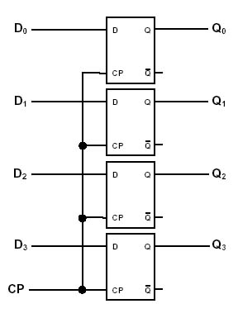
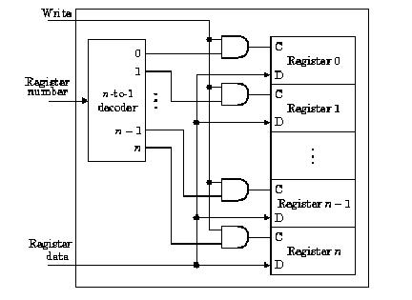
Machine Code 1: Registers (hardware)
Store numbers (1 number per register)
Hold data until they get a signal to store new data
Think of them like whiteboards that can only have 1 number on them
Connecting a decoder to registers helps a CPU pick which registers to use
Example of a 4-bit register
D₀ through D₃ are the input numbers
Q₀ through Q₃ are the outputs. These get sent to the CPU (brain of the computer)
CP is the clock pulse. It tells the registers when to save new numbers
Can hold any number between 0 and 2⁴-1

Slide 14
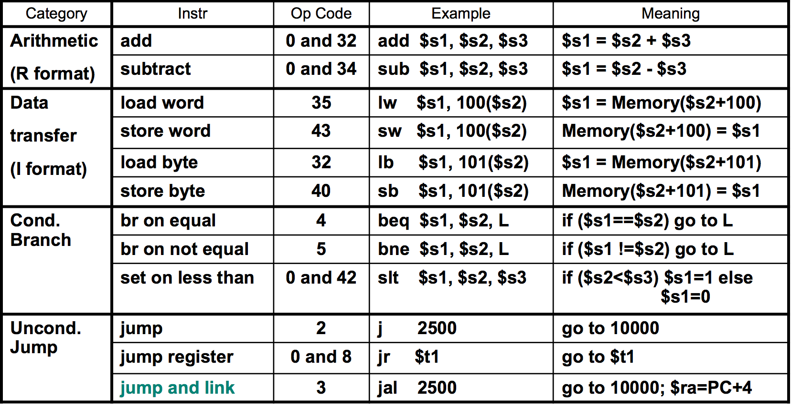
Machine Code 2: Instructions (software)
Instructions that tell the computer what operation to do, what data to use, and where to store the result.
Sample list of Instructions
Example code in Hexidecimal: 0xF3A8
Same command in Binary: 1111 0011 1010 0100
F 3 6 8
F = operation or “opcode” (ex. Addition)
3 = first source register (R3)
6 = second source register (R6)
8 = target register (R8)
This command would add the numbers in register 3 and register 6 and store the result in register 8

Slide 15
Point and click programming
Environments: Excel, Powerpoint, etc…
Languages: C, C++, Java, R, Python, HTML
Example: int counter = 1; (find memory to store an integer
variable, name it counter, and set it equal to 1)
High level
language
Language: Assembly
Example command in Hex (base 16): 0xF3A8
Same command in Binary (base 2): 1111 0011 1010 0100
Machine code
(individual instructions)
Logic gates
Universal Gates: AND, OR, NOT
Example: ABC (A and B and C)
Example: A+B+C (A or B or C)

Slide 16

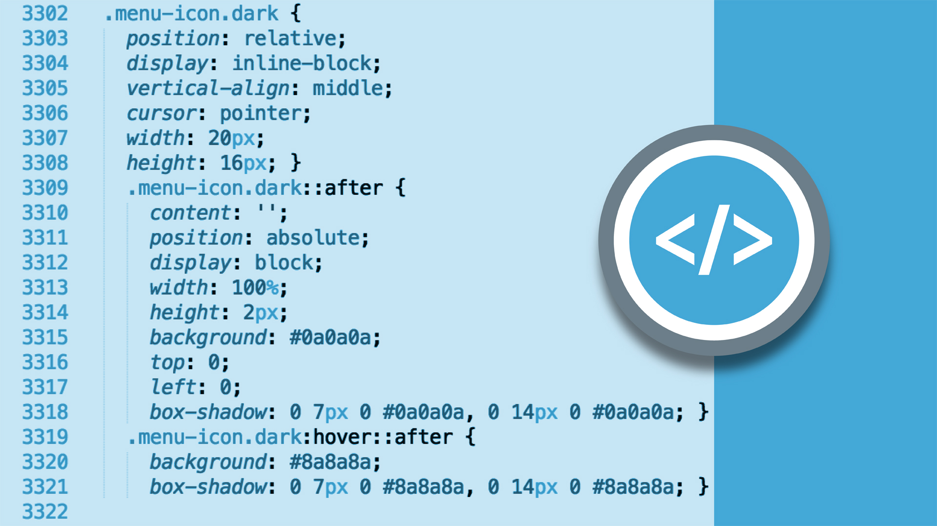
Basic Languages 1: Styling/Markup Languages
Languages: HTML, CSS, XML etc.
Takes data and displays it an a certain way
Does not edit data
Used for creating tables, bolding/italicizing, creating hyperlinks, etc..
Uses
Webpage design
Information displays
Help humans interpret/interact with data

Slide 17
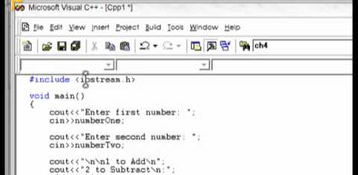
Basic Languages 2: General Purpose Languages
Examples: C, C++, Java, R, Python, etc…
Math/logic based
Takes inputs to generate outputs
Changes data/files
Low level languages
Low level languages create few computer instructions for each line of code
High level languages
High level languages create many computer instructions for each line of code
Sample C++ code
The start of this program asks for the user to input 2 numbers, then it calculates the difference and outputs it to the screen a couple lines down
Notes:
This is where most computer programming happens

Slide 18
Point and click programming
Environments: Excel, Powerpoint, etc…
Languages: C, C++, Java, R, Python, HTML
Example: int counter = 1; (find memory to store an integer
variable, name it counter, and set it equal to 1)
High level
language
Language: Assembly
Example command in Hex (base 16): 0xF3A8
Same command in Binary (base 2): 1111 0011 1010 0100
Machine code
(individual instructions)
Logic gates
Universal Gates: AND, OR, NOT
Example: ABC (A and B and C)
Example: A+B+C (A or B or C)

Slide 19
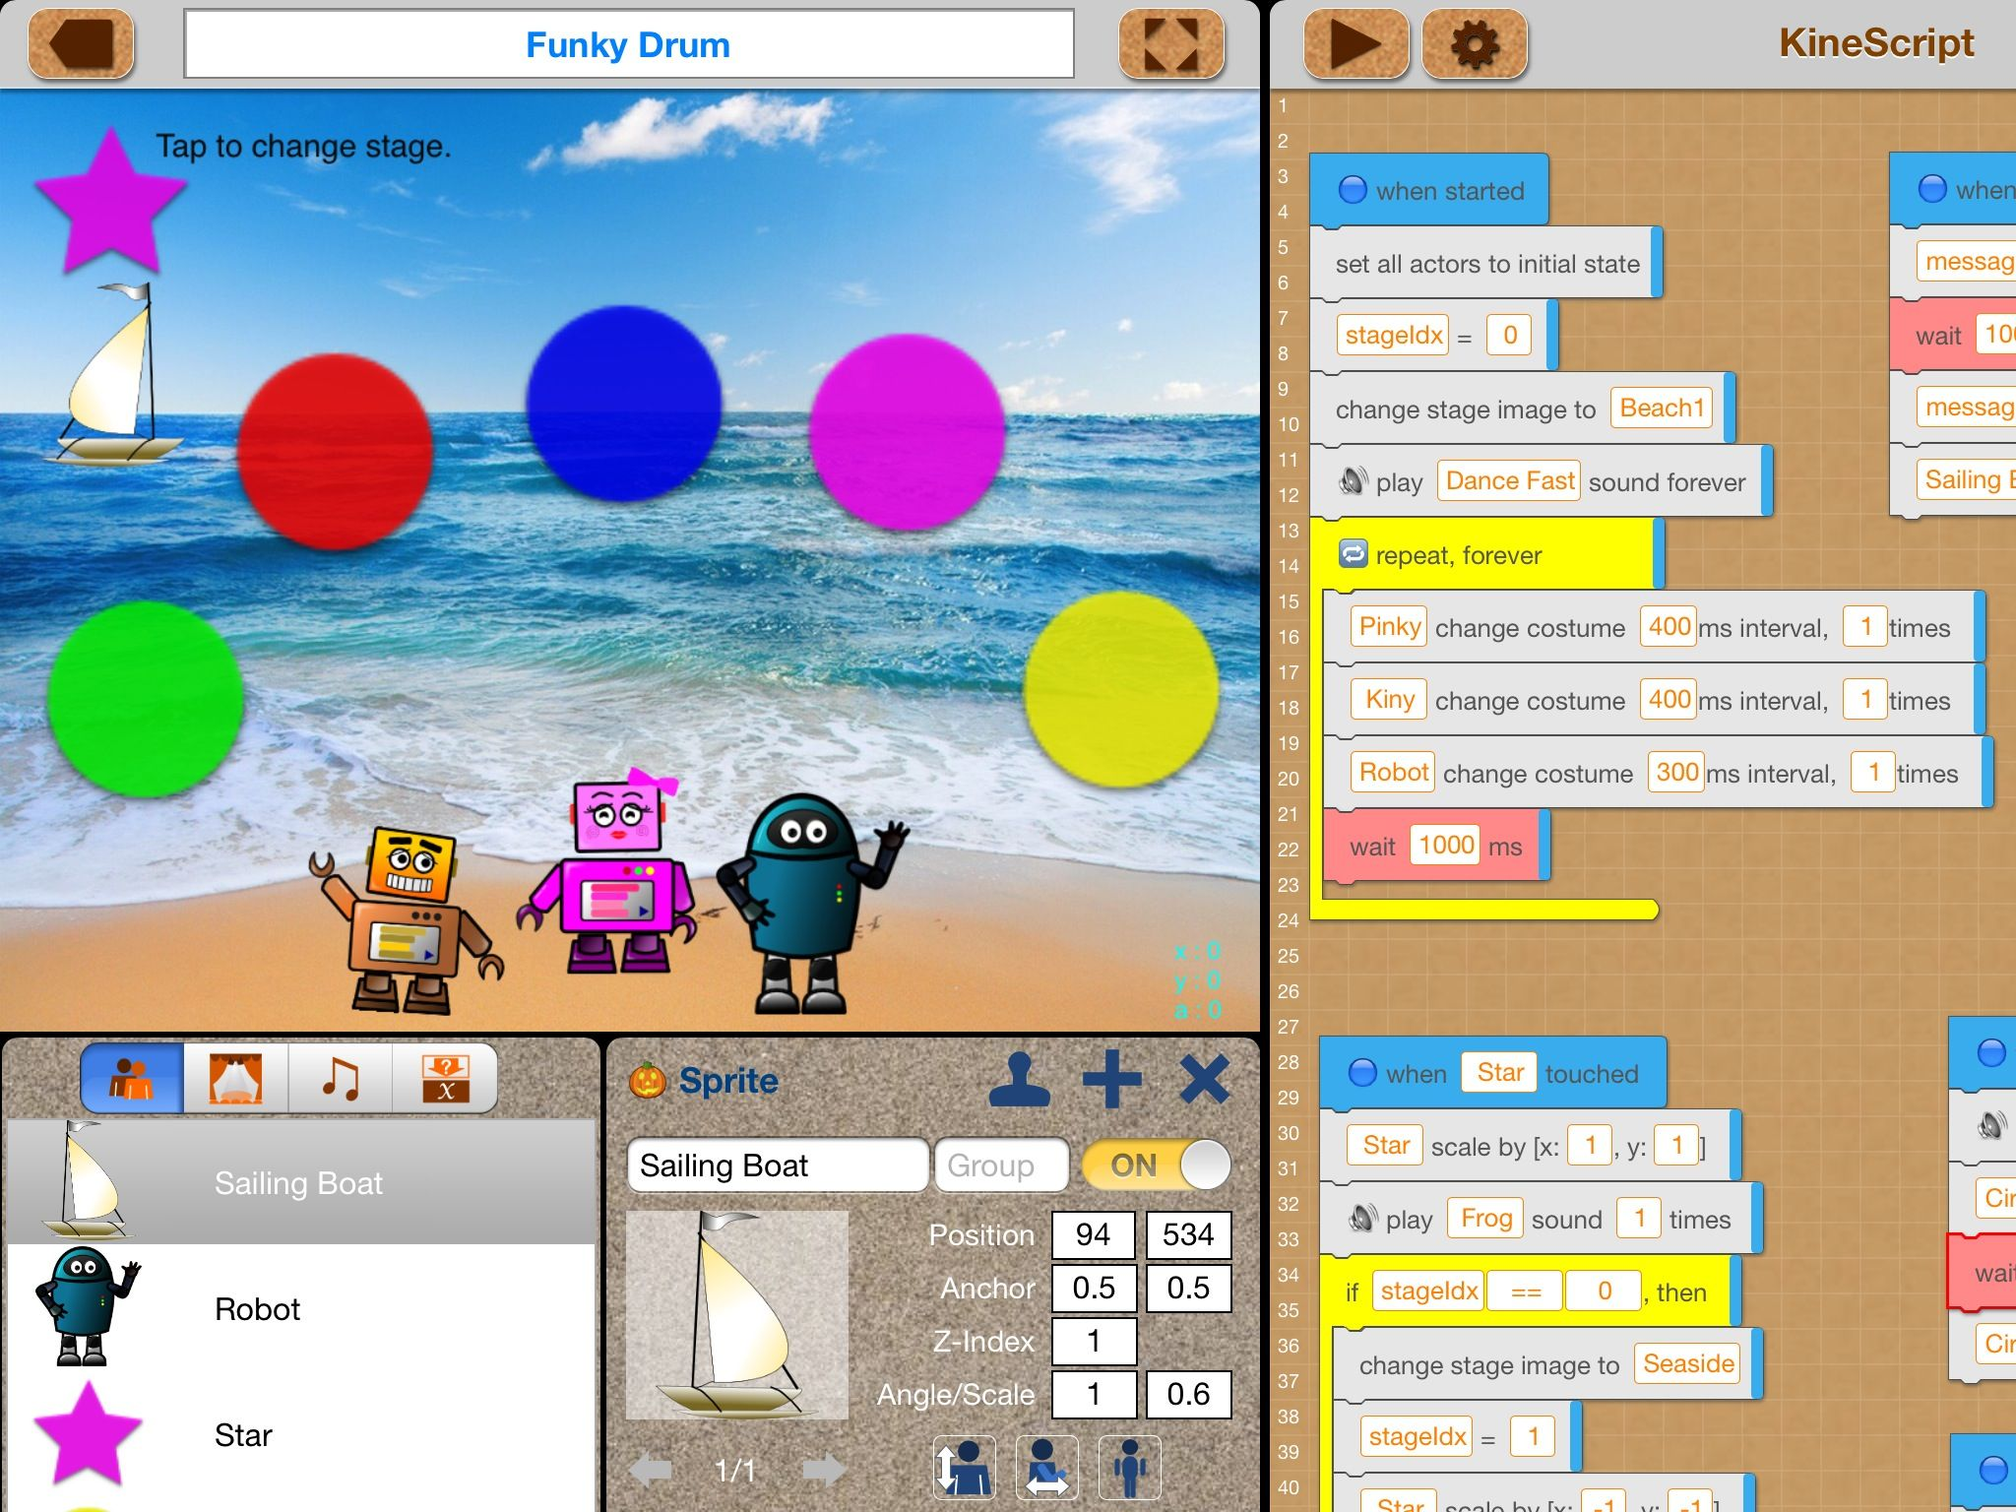
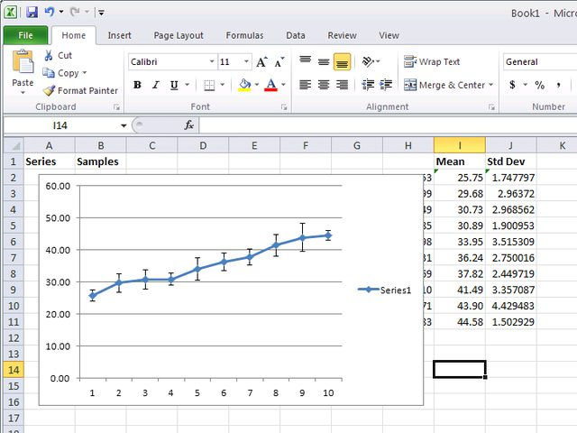
Point and Click/Scripted Programming
High level programs automatically create written code
Limits the need to write in base languages
It’s the fastest way to build tools to manipulate and present data
This program takes big chunks of code and simplifies them down so a coder can quickly make a game
Excel has preprogrammed plots and will automatically generate graphs with the push of a button

Slide 20
How Computers Work

Slide 21
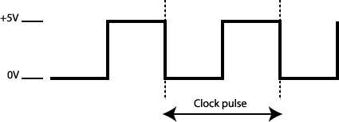
Internal clock
Processors have a “speed” at which they operate (ex. 2.4 GHz)
2.4 GHz means the processor can do 2.4 Billion things per second
Having multiple cores means a computer can do multiple things at once
Do command #2019
Do command #2020
Ex. 240 picoseconds

Slide 22
Computer Instructions
Every clock pulse, a new instruction is read and executed.
Arithmetic instructions: Addition, subtraction, multiplication, division, comparing numbers, setting values
Flow control instructions: Branching or conditional branching (jumping to a new instruction)
Line address
Each line of computer code is an instruction, with a unique address

Slide 23
How Basic Code becomes Machine Language

Slide 24
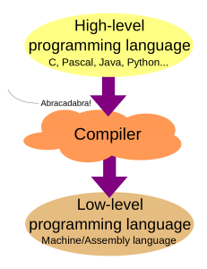
Compilers
A compiler is a program that turns a code in a certain language into a lower level code.
Generally it takes more lines of code to do the same operations in a lower level language
Ex. GCC is the name of a compiler that turns C/C++ code into machine code

Slide 25
Anything Else?

